Slide 1
MISCONCEPTIONS ABOUT WOMEN IN ISLAM
KABIR HASAN KHAN

Slide 2
OBJECTIVE
WOMEN OF TODAY AND OF THE PAST HAVE BEEN VICTIMS OF CULTURAL AND SOCIETAL POWER STRUGGLE
PEOPLE PERCEIVE WOMEN IN ISLAM ASSOCIATED WITH SEVERAL NEGATIVE CONNOTATIONS
MANY BLAME THESE NEGATIVE PRACTISES VIOLATING THE HUMAN RIGHTS
THERER IS NO DENYING THAT THESE PRACTISES ARE STILL VERY PREVELANT IN THE SOCIETY AND ARE DEEPLY ROOTED
THE MAIN OBJECTIVE OF THIS PROJECT IS TO PROVE THAT THESE PRACTISES ARE NOT ONLY UNCONSTITUTIONAL AND NOT WRITTEN IN THE HOLY QURAN AS THEY ARE UNDERSTOOD AND PRACTISED TODAY

Slide 3
INTRODUCTION
IN THIS PROJECT WE ARE GOING TO TOUCH UPON THE ON ISSUES OF –
Rights
Harems
Purdah
Education
Triple talaq
Khula
Nikah halala
Divorce
Status of mothers
Importance of daughters
Property rights

Slide 4
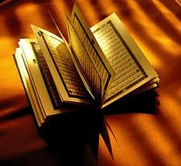
RIGHTS
THE QURN SAYS WOMEN HAVE EQUAL SPIRITUAL WORTH IN SIGHT OF ALLAH
ACCORDING TO OUR CONSTITIUTION (QURAN)WOMEN HAVE THE RIGHT TO –
WORK
BE PROTECTED
MODEST DRESS

Slide 5
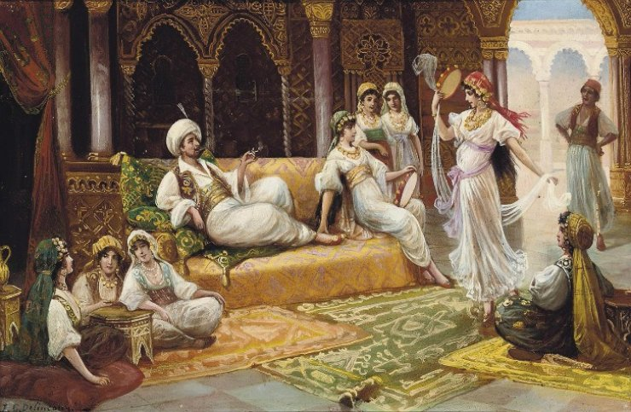
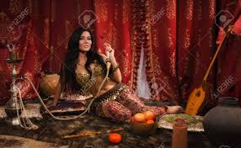
HAREMS

Slide 6
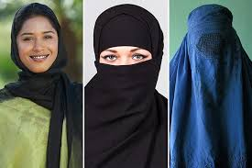
PURDAH
Pic of ladu doin purdah

Slide 7
EDUCATION
THESE ARE SOME VERSES FROM THE QURAN -
“Seeking knowledge is mandatory for every Muslim.”
“If anyone travels on a road in search of knowledge, Allah will cause him to travel on one of the roads of Paradise. The angels will lower their wings in their great pleasure with one who seeks knowledge, the inhabitants of the heavens and the Earth and the fish in the deep waters will ask forgiveness for the learned man. The superiority of the learned man over the devout is like that of the moon, on the night when it is full, over the rest of the stars.

Slide 8
Intellectual Abilities Of Two Wives Of Prophet Muhammad
BIBI Aishah
BIBI Khadijah

Slide 9
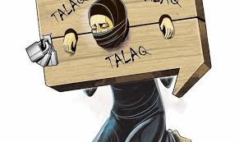
TRIPLE TALAQ OR IDDAH
According to surah nisa (4:35)-
And if you fear dissension between the two, send an arbitrator from his people and an arbitrator from her people. If they both desire reconciliation, Allah will cause it between them. Indeed, Allah is ever Knowing and Acquainted [with all things].

Slide 10
KHULA
A KISSA –
In the time of the Prophet , the wife of Thabit ibn Qais , both were Sahaba, a first generation Muslim , someone who was converted by prophet Muhammad(pbuh) himself. Thabit ibn Qais’s wife requested the Prophet for a divorce from her husband. The Prophet asked her to return the garden given to her at the time of marriage as dower (Mahr). She accepted this condition and the marriage was dissolved.

Slide 11
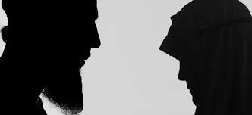
NIKHA HALALA
Nikah halala is a law that requires a woman to marry and consummate her marriage with another man in order to return to her first husband

Slide 12
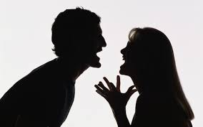

DIVORCE IN ISLAM
THE QURAN STATES -
Where the wife suffers physical, financial or emotional harm from the husband. Any violence in the marriage is condemned by Islam.
Where the husband suffers certain physical defects, such as impotency .
Adultery or infidelity.
SOME TIMES DIVORCE IS NOT ALLOWED WHEN THE –
WOMAN IS HAVING HER PERIOD
SHE IS IN HR POST NATAL REST PERIOD
OR IF SHE IS PREGNANT . IN CASE OF PREGNANCY TILL THE BABY IS BORN THE HUSBAND HAS TO TAKE CARE OF HER AND THE BABY TILL THE MILKING STAGE OF THE MOTHER GETS COMPLETED

Slide 13
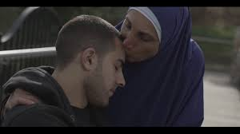
STATUS OF MOTHERS IN ISLAM
A man came to the Prophet and said, ‘O Messenger of God! Who among the people is the most worthy of my good companionship? The Prophet said: Your mother. The man said, ‘Then who?’ The Prophet said: Then your mother. The man further asked, ‘Then who?’ The Prophet said: Then your mother. The man asked again, ‘Then who?’ The Prophet said: Then your father.
A man once consulted the Prophet Muhammad about taking part in a military campaign. The Prophet asked the man if his mother was still living. When told that she was alive, the Prophet said: “(Then) stay with her, for Paradise is at her feet.”
On another occasion, the Prophet said: “God has forbidden for you to be undutiful to your mothers.”

Slide 14
AN OTHER KISSA –
MOSSES OR MUSA USED TO TALK TO ALMIGHTY [ALLAH] FROM A MOUNTAIN IN EGYPT …..AFTER HIS MOTHER PASSED AWAY HE WAS VERY UPSET AND WAS TOLD BY ALLAH “BE WARE MOSSES , OF EVERY LITTLE THING YOU DO , AS YOUR MOTHER IS NO MORE TO PRAY FOR YOU”
THIS AGAIN SHOWS THE IMPORTANCE OF MOTHERS IN ISLAM

Slide 15
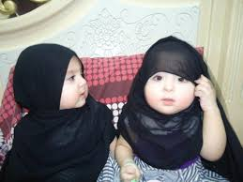
IMPORTANCE OF DAUGHTERS IN ISLAM
THE QURAN SAYS -
1. Daughters are Great Blessings
2. Daughters are the reason for the existence of humanity
3. A Daughter’s Father is Close to Muhammad SAW
4. Daughters Brings Double Blessings
5. Daughter is a Shield for Her Parents
6. Raising a Daughter Will Guaranteed Paradise
7. A Daughter Distanced Her Parents from Hell

Slide 16
PROPERTY RIGHTS
THE QURAN DECLARES –
“For men there is a share from what their parents and close relatives leave, and for women there is a share from what their parents and close relatives leave, be it little or considerable; a definite share.”
“Allah charges you in regard with your children: a son’s share is equal to the share of two daughters; if the [children] are [only] daughters and two or more, their share is two thirds of the legacy, and if there is only one daughter, her share is half [of the legacy]; and each of the parents inherit one-sixth of the legacy if the deceased had children, and if the deceased had no children and the parents are the only heirs, the mother inherits one-third; if the deceased had brothers, the mother inherits one-sixth; [all this is] after executing the will and settling the debts of the deceased. You do not know which of your parents and children benefit you the most. This is Allah’s injunction; surely Allah is All-knowing, All-wise.”

Slide 17
CONCLUSION
CERTAIN SECTION OF PEOPLE accuse Islam of being a religion which guides people to the wrong path WHICH THEY TERM AS JIHAD , instead it is these people who are interpreting Islam incorrectly.
While some of these are misinterpretations of the Quranic verses others have been deliberately twisted to suit people conveniences WHICH IS VERY EVIDENT AND HISTORY ALSO SUPPORTS IT AS WE HAVE READ IN THE CENTRAL ISLAMIC LANDS HOW DIFFERNT SECTS EMMERGED AND BROKE FROM THE MAIN STREAM ISLAM

Slide 18
BIBLOGRAPHY
https://www.al-islam.org/introduction-rights-and-duties-women-islam-ayatullah-ibrahim-amini/womens-inheritance-islam
https://azislam.com/importance-of-daughter-in-islam
http://www.islamic-sharia.org/khula/
https://www.google.co.in/search?biw=1600&bih=731&tbm=isch&sa=1&ei=m7gyWqm4MovXvAS6_ZSYDg&q=QURAN+&oq=QURAN+&gs_l=psy-ab.3..0l10.19034.24753.0.25966.13.9.0.1.1.0.242.1329.2-6.7.0....0...1c.1.64.psy-ab..5.7.1338.0..0i67k1.263.f1myHtbEgOM#imgrc=O98tVYRGuvspNM
. https://www.whyislam.org/social-ties-2/the-importance-of-girls-education-in-islam/
Living islam treading the path of the ideal by Ruqaiyyah Waris Maqsoodpublished , by goodword books 1998 edition , womens rights , page no. 86 to 110 .
Living islam treading the path of the ideal by Ruqaiyyah Waris Maqsoodpublished , by goodword books 1998 edition , divorce , page no. 229 to 243
http://islamic-stuff-corner.blogspot.com/2013/01/muslim-girl-babies-kids-wallpapers.html
https://www.youtube.com/watch?v=-CihFTMmMlM
https://www.telegraph.co.uk/news/2018/08/01/british-court-recognises-sharia-law-landmark-divorce-case/
https://nydivorcefirm.com/avoid-losing-everything-divorce/
https://www.newsnation.in/india-news/nikah-halala-victim-shabnam-rani-granted-security-supreme-court-orders-yogi-adityanath-government-in-uttar-pradesh-article-203049.html
http://dubeat.com/2017/09/triple-talaq-a-battle-against-three-words/
http://wsbuzz.com/world-news/difference-hijab-burka-niqab/
https://en.wikipedia.org/wiki/Quran
https://www.123rf.com/photo_21739049_beautiful-arabic-woman-with-hookah-in-a-harem.html
http://discovertr.com/wp-content/uploads/2018/01/harem.jpg

Slide 19
THANK YOU

